Slide 1

Computer Engineering Department A.P. Shah Institute of Technology G.B.Road,Kasarvadavli, Thane(W), Mumbai-400615 UNIVERSITY OF MUMBAI Academic Year 2019-2020

Slide 2
A Project Report on Self-Driving Car Using RaspberryPi and Ardiuno Submitted in partial fulfillment of the degree of Bachelor of Engineering(Sem-7) in Computer Engineering By Aishwarya Munchandi(161020) Manan Doshi(17102004) Aakash Singh(16102041) Under the Guidance of Amol Kalugade

Slide 3
1.Project Conception and Initiation

Slide 4
1.1 Abstract
Self Driving car is the most trending technology which already implemented in Tesla cars, As initially, you can learn about the technology by using this system.
For this, we are using OpenCV, Machine learning technology. This system contains Raspberry Pi as the core system, which having functionalities like, Traffic light detection, Vehicle detection, pedestrian detection, Road sign detection to make the car as autonomous. Every process is done using the Raspberry Pi with Python programming.
Block Diagram

Slide 5
1.2 Objectives
The main goal of self driving RC car is toavoid accidents.
2.Increasing roadway capacity by reducing the distancesbetween cars
3.People are free to concentrate on other tasks or to rest during theirjourneys.
4.The current location of vehicle can be determined using GPS

Slide 6
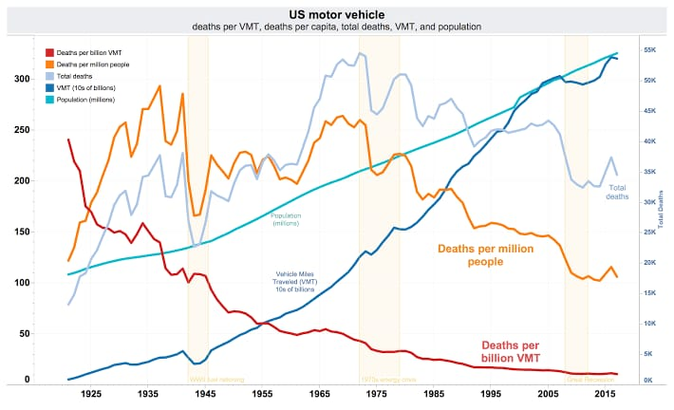
1.3 Literature Review
According to the National Highway Traffic Safety Administration (NHTSA), in 2016, the U.S. had 6.3MM car crashes, 2.5MM injuries from those crashes, and 37,461 fatalities from those crashes. Areas like avoiding the tens of thousands of fatalities every year are priceless, but here I will try to quantify the problems driverless cars solve. Below is a summary of areas I could quantify where we could have real annual savings in the U.S. alone:

Slide 7
1.4 Problem Definition
In order to increase roadway safety autonomous vehicles are under development and are the focus of many research projects.
The Rochester Institute of Technology wishes to have a reentry point to the field of autonomous vehicle research and currently does not have a vehicle to use as a starting point.
To facilitate RIT’s goal a remote control golf cart was determined to be the first stepping stone. The scope of this project includes converting a golf cart to a remote control vehicle.
The safety of the vehicle’s passengers and bystanders is of the utmost concern. Therefore the vehicle is required to be low speed and contain the ability for passengers to take control.

Slide 8
1.5 Scope
1.To run the chatbot car on the defined track using opencv. 2. The second part consist of the image processing in which the decision are made based on the image fed to the system.
a) turn left and right on the defined path
b) Traffic sign detection and based on the sign ,appropriate decision is put into action
c) Stop or Change the lane when obstacle is detected

Slide 9
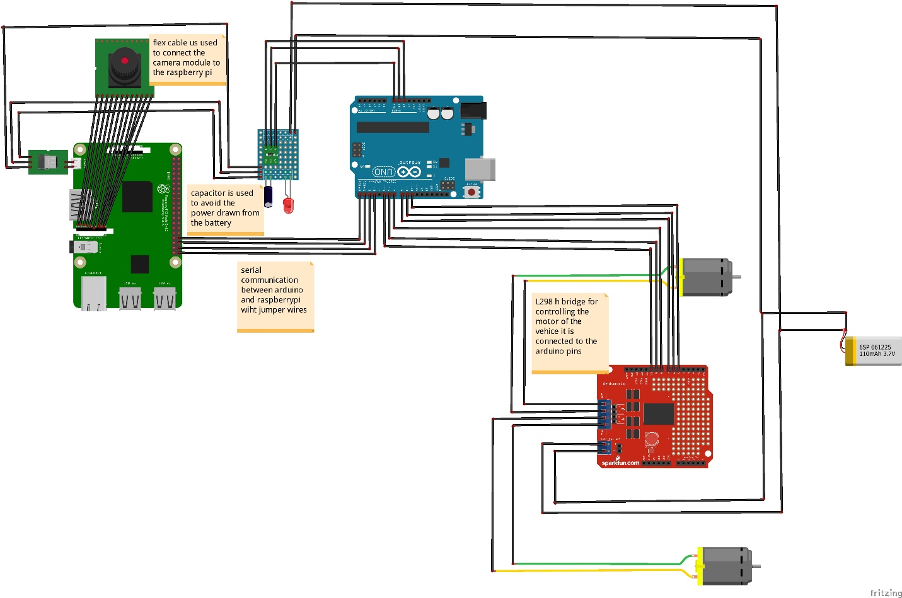
1.6 Technology stack

Slide 10
1.7 Benefits for environment & Society
1. Without the need for a driver, cars could become mini leisure rooms. Without the need for controls, there would be more space available inside the vehicle and no need for passengers to face forwards.
2.Entertainment technology, such as video screens, could be used without any concern of distracting the driver.
3.Human drivers notoriously bend rules and take risks, but driverless cars will obey every road rule and posted speed limit.
4.Reduced need for safety gaps, lanes, and shoulders means that road capacities for vehicles would be significantly increased.

Slide 11
2. Project Design

Slide 12
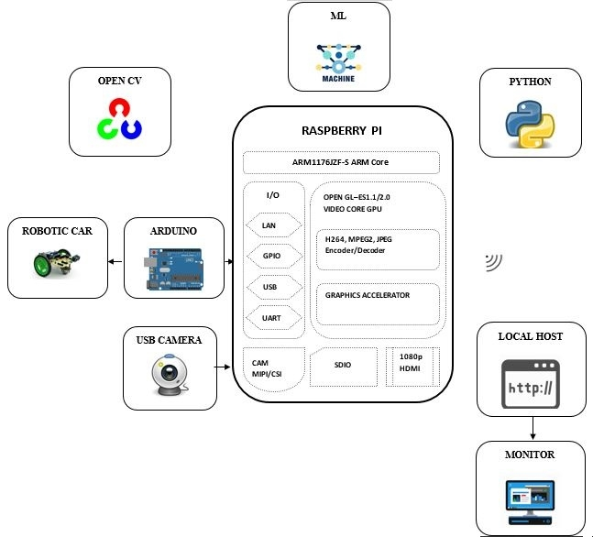
2.1 Proposed System

Slide 13
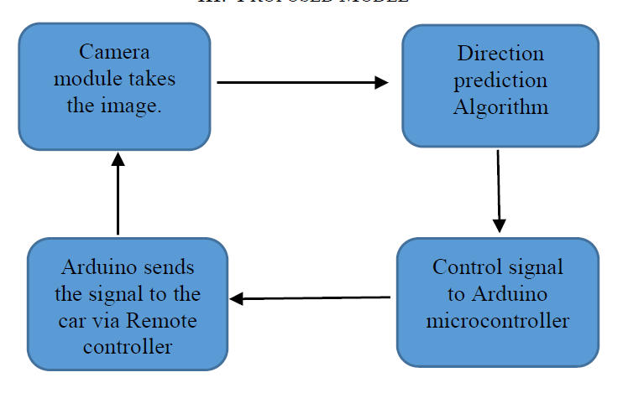
2.2 Design(Flow Of Modules)

Slide 14
2.3 Description Of Use Case
The above Use Case Diagram The main role is Pi Camera is used to detect which of the operation should be performed when any obstacle ,Lane direction, potholes or traffic signals occurred.
1. First Pi Camera take the front image and divide the image into pixels, then each pixels will be justify in CNN. After than decision will made.
2. If it is Traffic Signals, in that case it’s about Colour .Then there will be following rules:
i. If it is Red Colour, then the Car will be Stop.
ii. If it is Green Colour, then the Car will Start moving Forward direction.
iii .If it is Yellow Colour, then the Speed of Car will be decrease.
3.If the Image detected by Pi camera said it is Lane Direction picture, then there will be two ways to go:
i. If it is Right sign, Then the car will be moved in Right Direction
ii.If it is Left sign, Then the car will be moved in Left Direction
4.If there is no Path and it observed the U-Turn sign, then the cars is used to take U-turn.

Slide 15
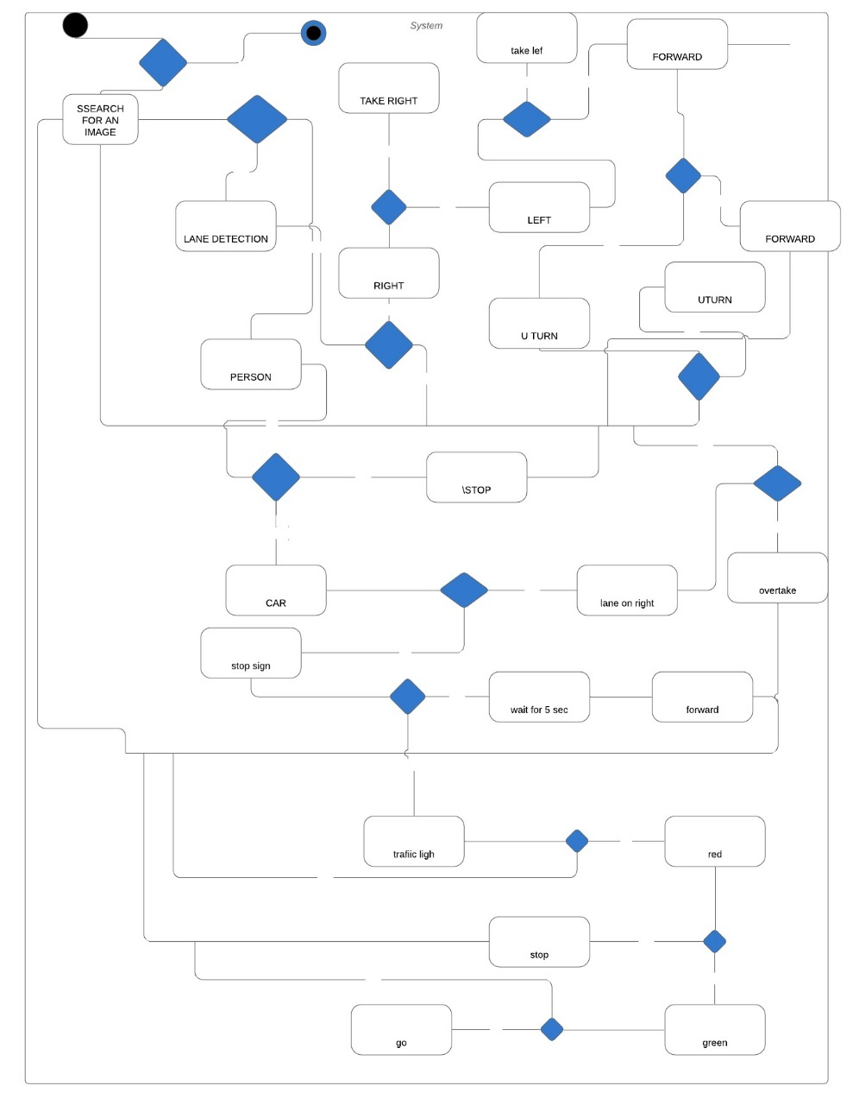
2.4 Activity diagram

Slide 16
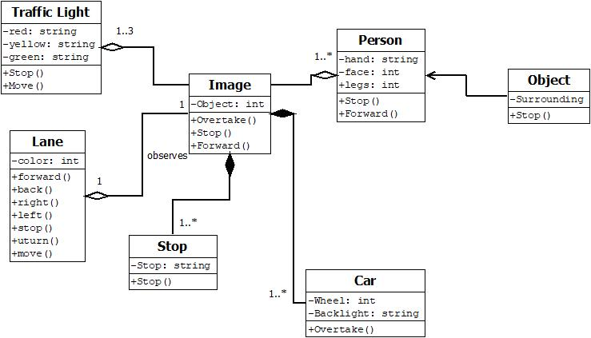
2.5 Class Diagram

Slide 17
1.Pi Camera
Pi camera is great gadget to capture time-lapse, slow motion with great video clarity.
The dimensions of camera are 25mm to 24mm by 9mm, which connects to Raspberry Pi via a flexible elastic cord which supports serial interface.
The camera image sensor has a resolution of five megapixels and has a focused lens. The camera provides a great support for security purpose.
Various characteristics of the camera are it supports 5MP sensor, Wide image, capable of 2592x1944 stills, 1080p30 video on Camera module v1

Slide 18
2.RaspberryPi
The Raspberry Pi is a small low cost single board computer having a processor speed ranging from 700 MHz to 1.2 GHz for the Pi 3.
The on-board memory ranges from 256 MB to 1 GB RAM. The boards supports up to 4 USB ports along with HDMI port. Along from all this it has number of GPIO pins which support protocols like I²C.
Moreover it also supports Wi-Fi and Bluetooth facility which makes device very compatible with other devices.
It supports Scratch and Python programming languages .
It supports many operating systems like Ubuntu MATE, Snappy Ubuntu, Pidora, L.

Slide 19
3.Ardiuno Uno
This microcontroller is based on Atmega329P.
There are 14 digital input/output pins available out of which 6 ca n be used a PWM outputs.
It also supports 6 analog inputs. It has 16 MHz quartz crystal, a USB connection, a power jack, an ICSP header and a reset button.
It has 32 kb of flash memory and 2 kb of SRAM and weighs around 25g .
Apart from all these features Arduino IDE is very user friendly and uses basic c as its programming language After attaching these hardware on the car and connecting Arduino with the controller.

Slide 20
4.Ardiuno IDE
Ardino IDE is the platform were the programs are written for Arduino board.
It has compile button which helps in compiling the code along with the upload tab which helps to upload the code on the board.
Programs written on Arduino IDE are often called Sketches and are saved as .ino extension.
The editor has numerous other features like verify, save, upload , include library and serial monitor.Apart from this ,the developers have made easy to use functions, which makes coding easy and fun.
Moreover there are number of examples provided for each and every interface which helps the user learn more about functions and hardware.

Slide 21
5.OpenCV
OpenCV is an open source computer vision library which is capable of handling images/videos from fairly basic tasks to utter complex tasks like facial recognition.
It supports C++, C, Python and Java programming languages and supports Windows, Linux, Mac OS, iOS and Android. Written in optimized C/C++, the library can take advantage of multi-core processing.
Enabled with OpenCL, it can take advantage of the hardware acceleration of the underlying heterogeneous compute platform .
In this project it is serving a major support, it helps to crop out the section of the video from the Raspberry-Pi cam interface as shown above and converts it to the grayscale, resize it and then passes it to the Convolutional Neural Network.
Spyder is a powerful interactive development environment for the Python language which has advanced editing, interactive testing, debugging and introspection features and a numerical computing environment. It has a matplotlib as plotting library which helps to plot 2D/3D graphs.

Slide 22
6.CNN
Python:
It is the programming language used for Machine Learning or Artificial Intelligence
Google Colab:
Colab is a free cloud-based Jupyter Notebooks that let you write and train deep learning models in Python. The popular python libraries supported are TensorFlow, Keras, OpenCV, and Pand

Slide 23
2.7 References
https://towardsdatascience.com/turning-a-raspberry-pi-3b-into-an-object-recognition-server-with-intel-movidius-ncs2-8dcfebebb2d6
https://emerj.com/ai-sector-overviews/ai-for-self-driving-car-safety-current-applications/
https://techcrunch.com/2019/10/01/streamlit-launches-open-source-machine-learning-application-development-framework/

Slide 24
3.Planning for next semester

Slide 25
Planning
To run car on define path
Object detection
Sign detection

Slide 26
Thank You

